Slide 1
Markov Models
Charles Yan
2008

Slide 2
Markov Chains
A Markov process is a stochastic process (random process) in which the probability distribution of the current state is conditionally independent of the path of past states, a characteristic called the Markov property.
Markov chain is a discrete-time stochastic process with the Markov property
I will use a gene finding example (to be exactly, CpG islands identification) to show Markov chains, since it is a simple and well-studied case.
The same approach can be used to other problems.

Slide 3
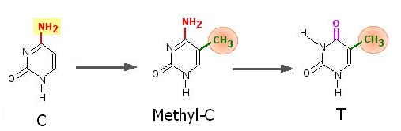
Markov Chains
The CG island is a short stretch of DNA in which the frequency of the CG sequence is higher than other regions. It is also called the CpG island, where "p" simply indicates that "C" and "G" are connected by a phosphodiester bond.
Whenever the dinucleotide CpG occurs, the C nucleotide is typically chemically modified by methylation.
  C of CpG is methylated into methyl-C.
  methyl-C mutates into T relatively easily.

Slide 4
Markov Chains
Thus, in general, CpG dinuclueotides are rarer in the genome. F (CpG) < f(C) * f(G).
Methylation process is supressed before the “starting point” of many genes.
These regions (CpG islands) have more CpG than elsewhere.
Usually, CpG islands are a few hundred to a few thousand bases long.
Identification of CpG islands is important for gene finding.

Slide 5
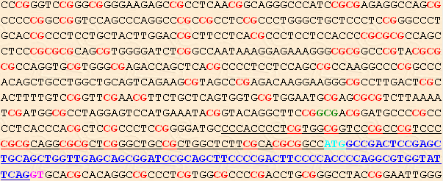
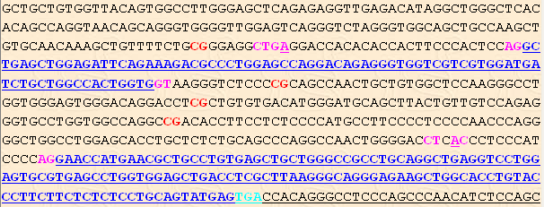
Markov Chains
APRT
(Homo Sapiens)

Slide 6
Markov Chains
We want to develop a probabilistic model for CpG islands, such that every CpG island sequence is generated by the model.
Since dinucleotides are important, we want a model that generates sequences in which the probability of a symbol depends on the previous symbol.
The simplest one is a Markov chain.

Slide 7
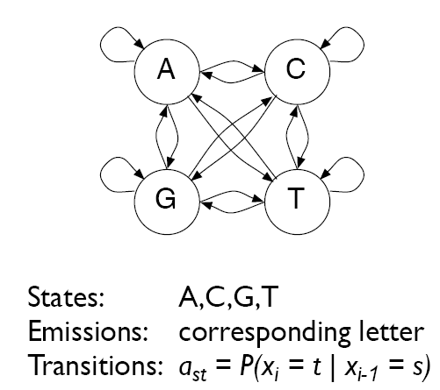
Markov Chains

Slide 8

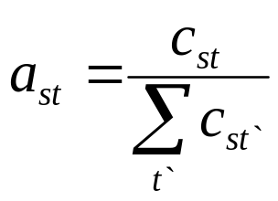
Markov Chains
Training the model, i.e., estimate the transition probabilities
Maximum likelihood (ML) approach is used to estimated the transition probabilities
Where C_{st} is the number of times that letter t followed letter s

Slide 9
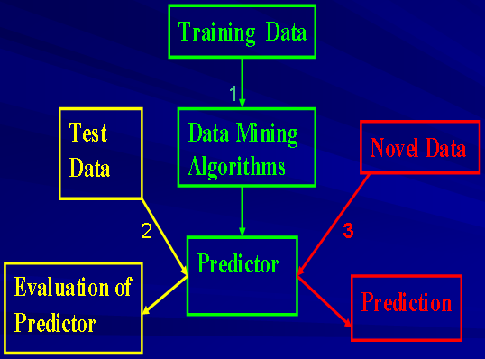
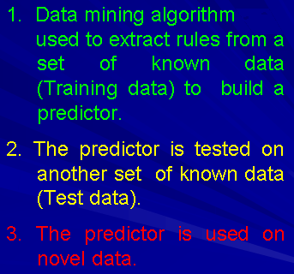
Prediction Using Data-Mining Approach
is

Slide 10
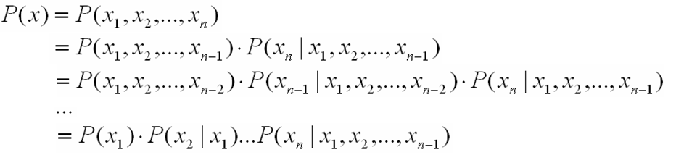

Markov Chains
The probability that a sequence x is generated by a Markov chain model
By applying many times of

Slide 11



Markov Chains
One assumption of Markov chain is that the probability of x_{i} only depend on the previous symbol x_{i-1}, i.e.,
Thus,

Slide 12
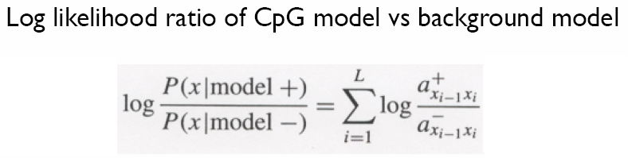
Markov Chains
Given a sequence x, does it belong to CpG islands?
If the log likelihood ratio >0, then x belongs to CpG islands.

Slide 13

Markov Chains
In this model, we must specify the probability P(x₁) as well as the transition probabilities .
To make the formula homogeneous (i.e., comprise of only terms in the form of ), we can introduce a begin state to the model.

Slide 14
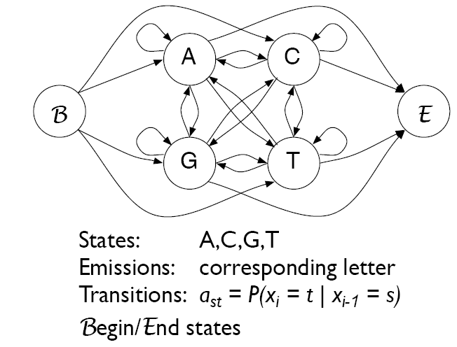
Markov Chains

Slide 15
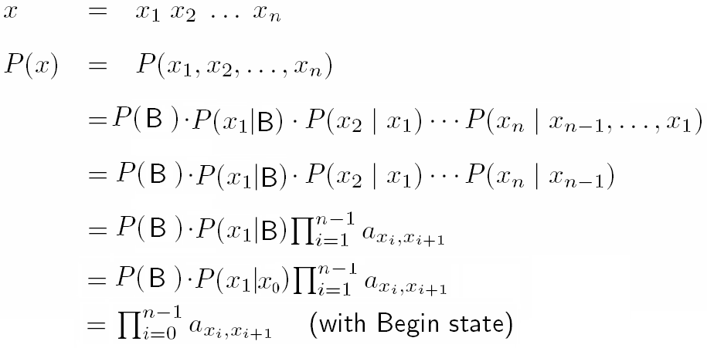
Markov Chains
The probability that a sequence x is generated by a Markov chain model (with a begin state)

Slide 16
Markov Chains
Training the model, i.e., estimate the transition probabilities
Maximum likelihood (ML) approach is used to estimated the transition probabilities
Where C_{st} is the number of times that letter t followed letter s

Slide 17
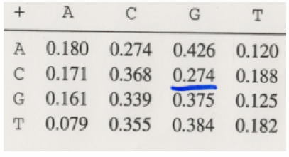
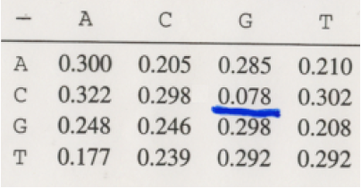
Markov Chains
A set of CpG islands
(CpG model)
  1st row: The probabilities that A is followed by each of the four bases.
  The sum of each row is 1
A set of sequences that are not CpG islands
(Background model)

Slide 18
Markov Chains
Given a sequence x, does it belong to CpG islands?
If the log likelihood ratio >0, then x belongs to CpG islands.

Slide 19
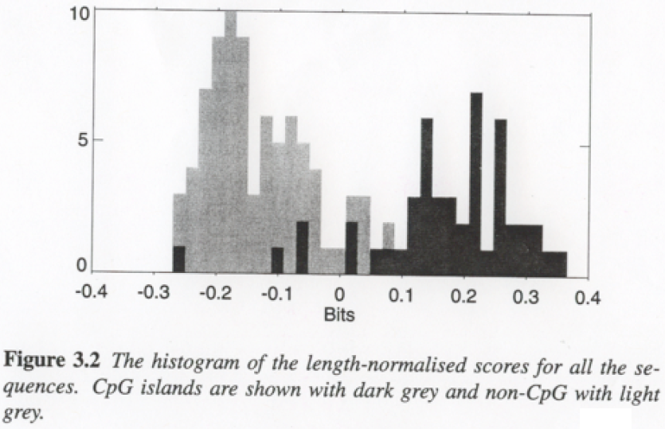
Markov Chains

Slide 20
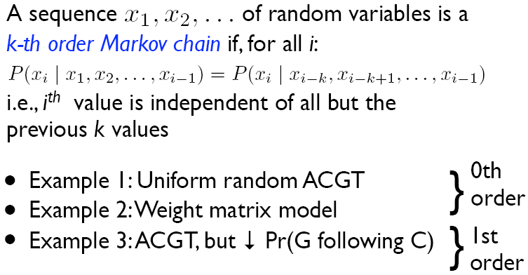
Markov Chains

Slide 21
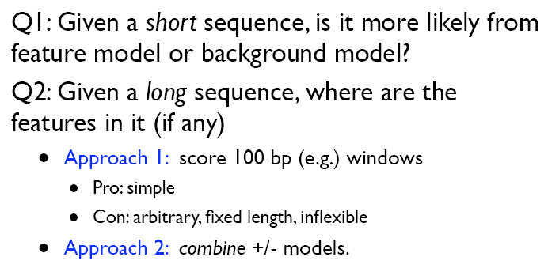
Markov Chains

Slide 22
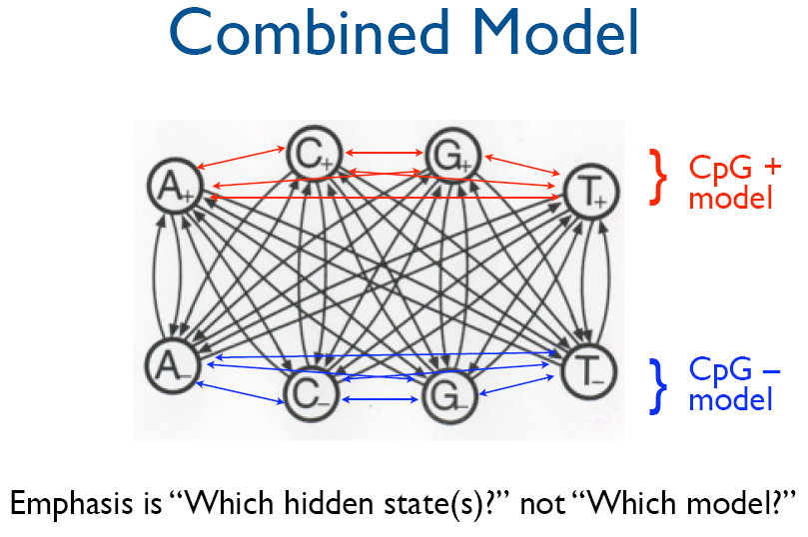
Markov Chains to Hidden Markov Models

